Slide 1
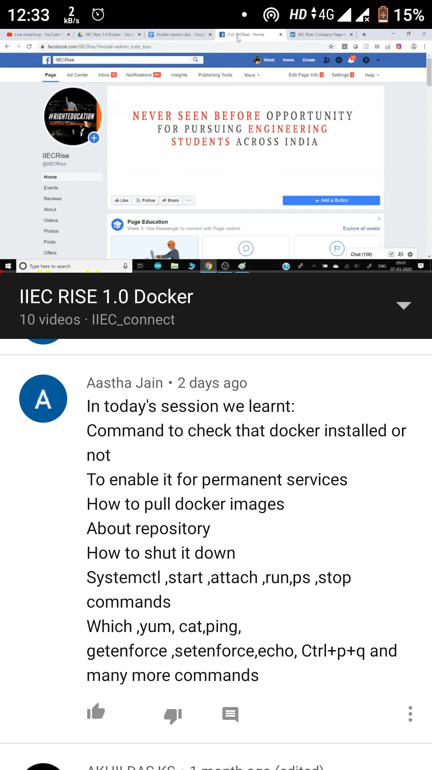
Day 1 ATTENDANCE

Slide 2
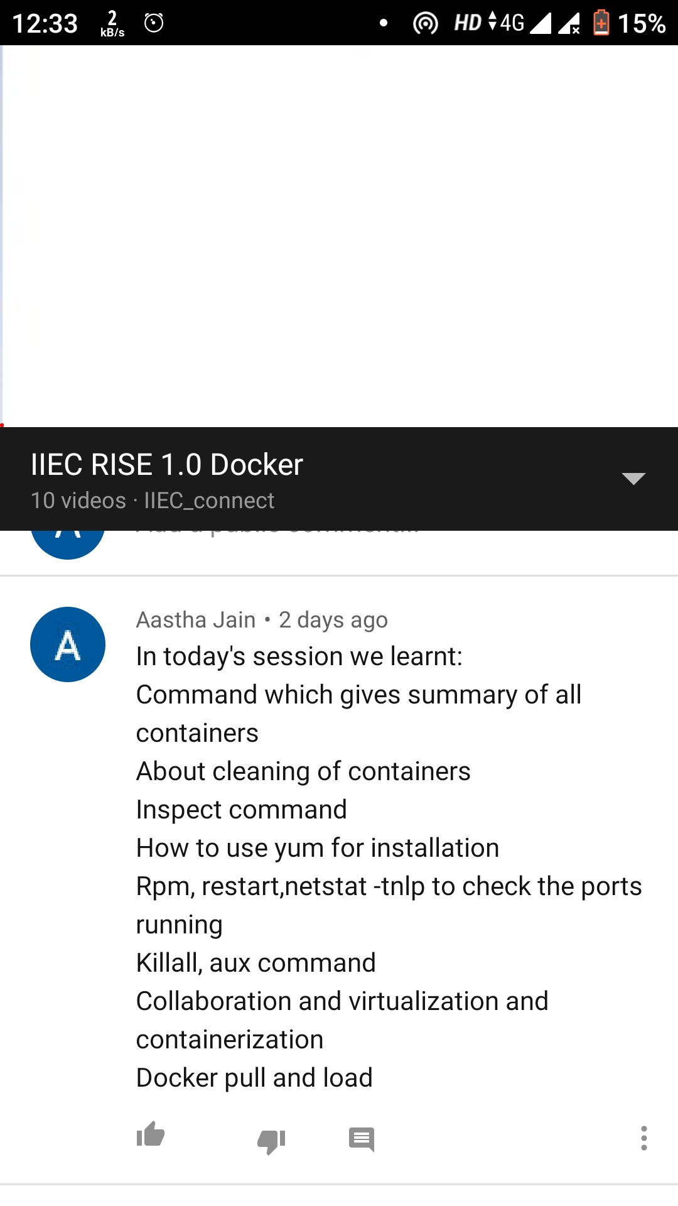
Day 2 Attendance

Slide 3
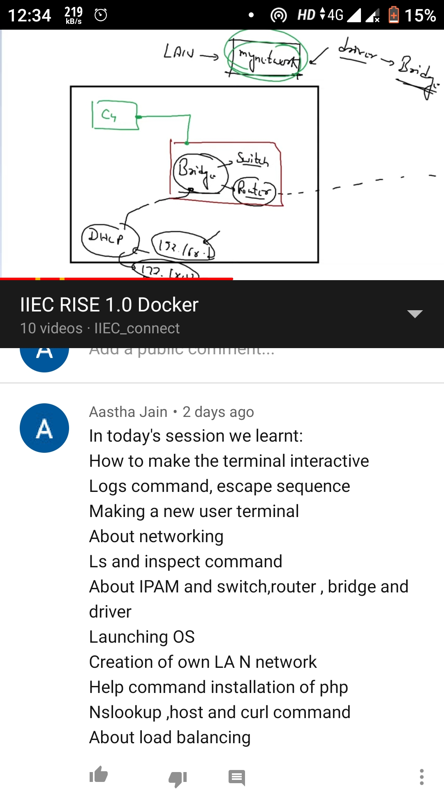
Day 3 Attendance

Slide 4
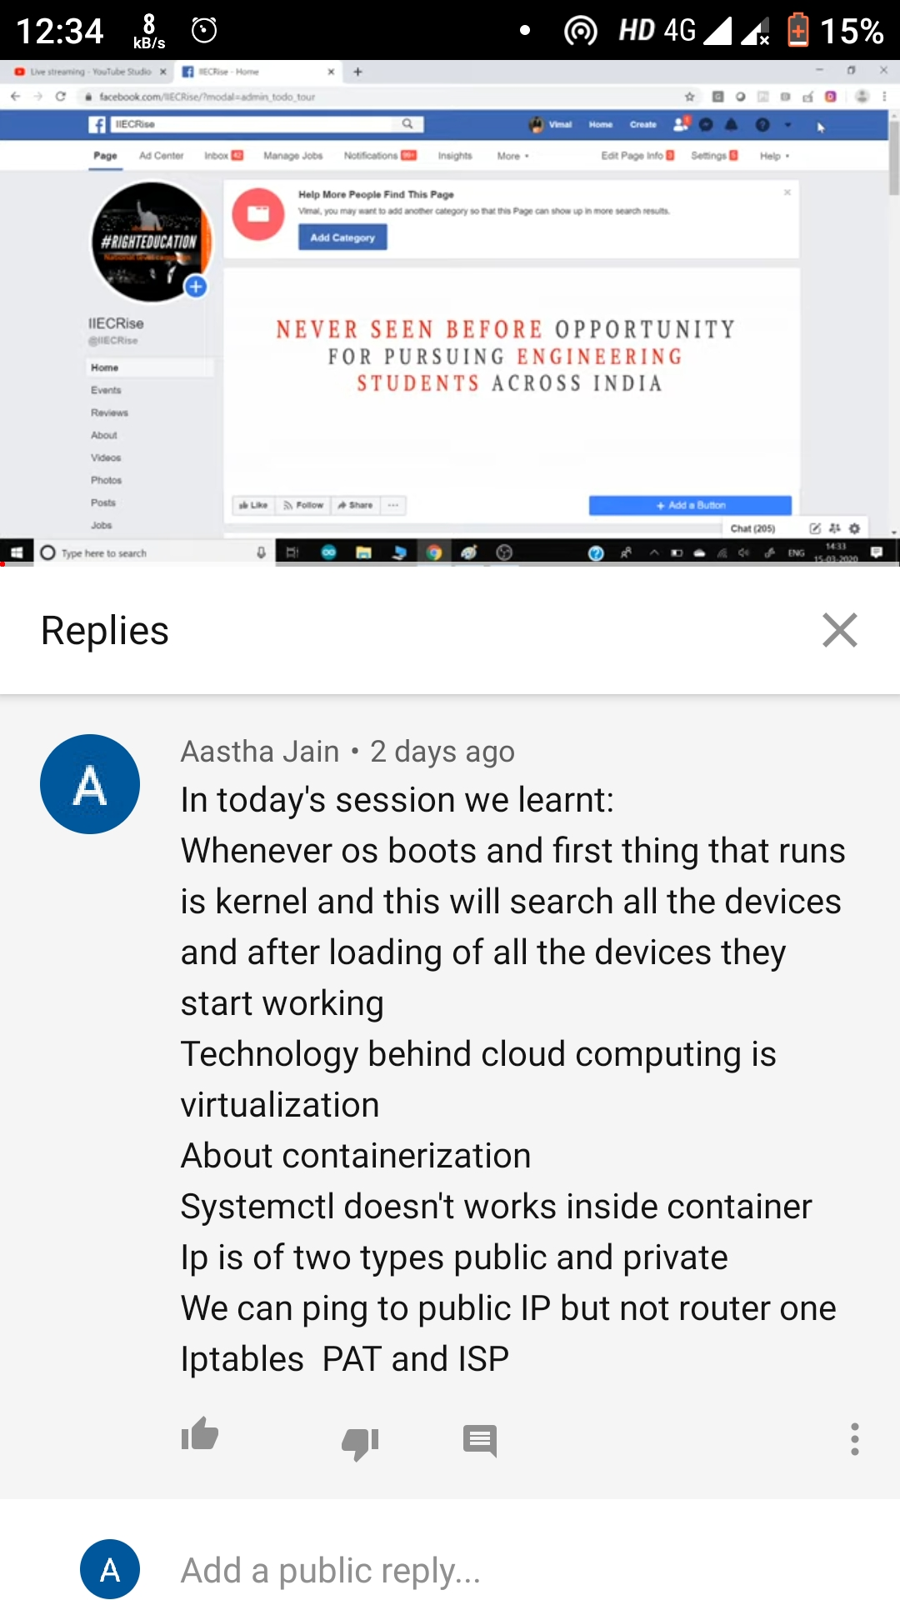
Day 4 Attendance

Slide 5
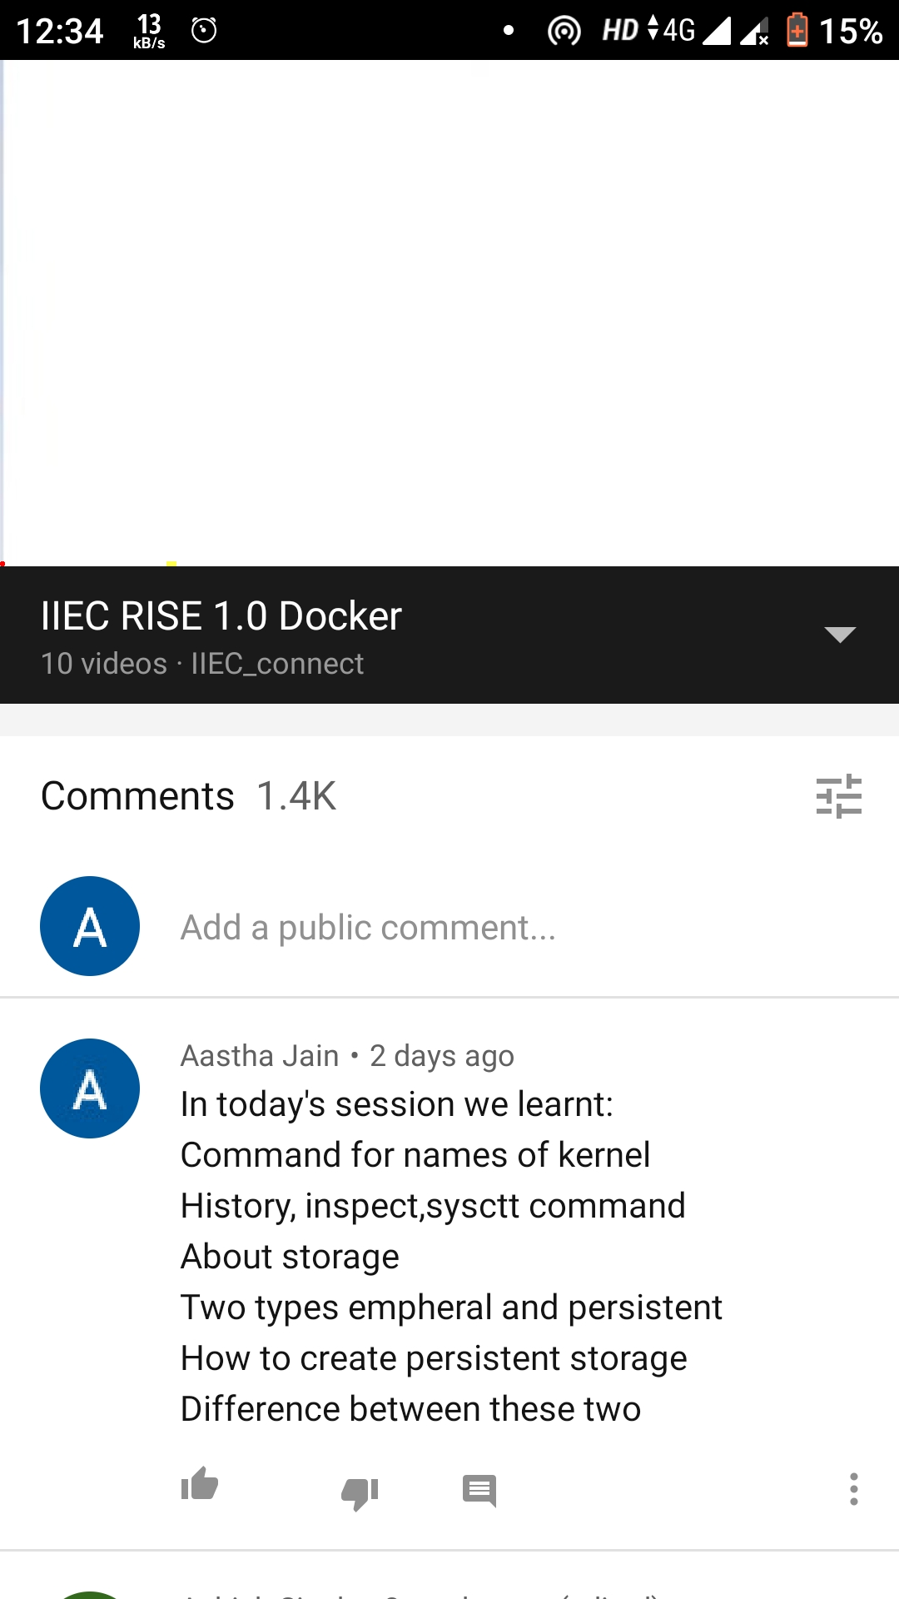
Day 5 Attendance

Slide 6
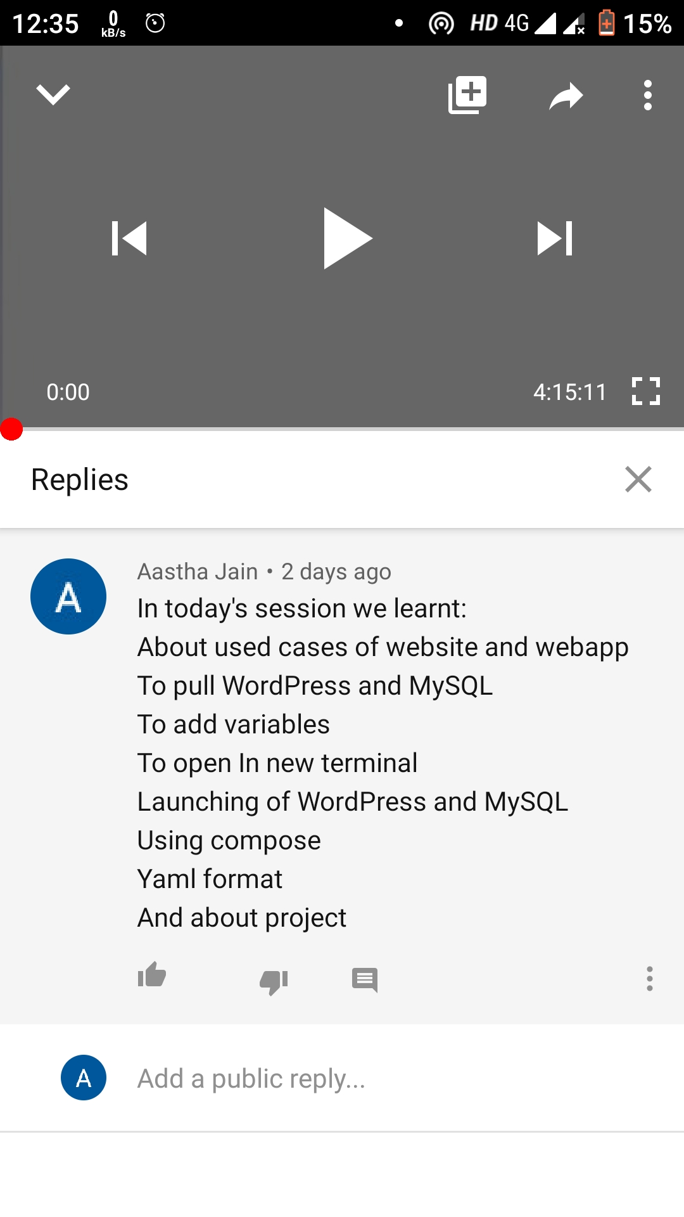
Day 6 Attendance

Slide 7
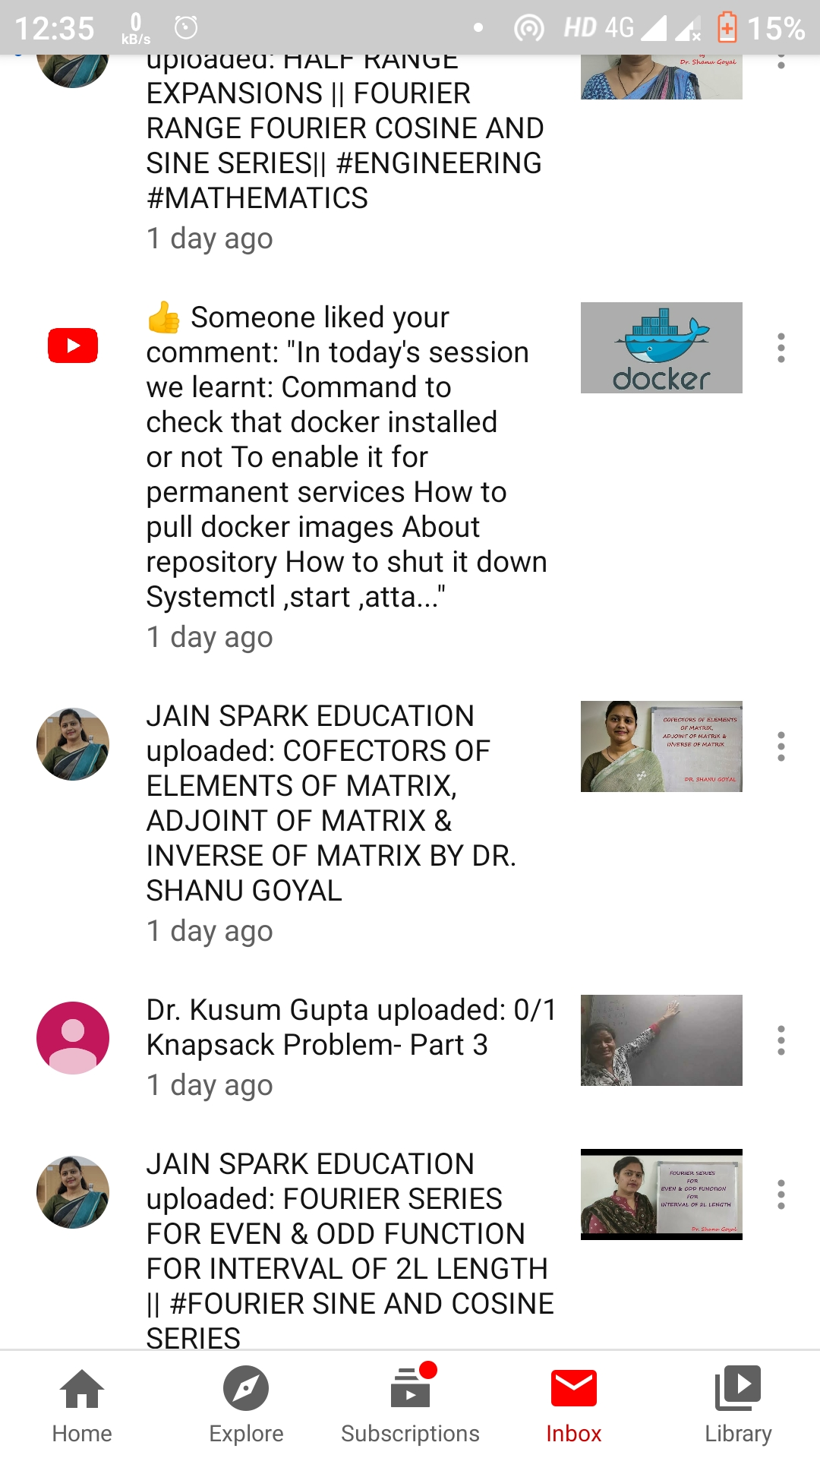
Random people liked my comments😄

